Slide 1
Vodafone MachineLink 3G
LED status display and operation mode
Feature Spotlight

Slide 2
What is the LED status display and operation mode?
The MachineLink 3G Router has 7 LED indicators on its front panel.
Each LED indicator is capable of displaying three colours; green, amber and red.
Notes:
Trainer Notes
Highlight the objectives to be covered within the course.
Do not present this slide just include it in the delegate notes.

Slide 3
The Power LED indicator
The power LED has the following status states:
COLOUR | state | Description
 | Off | Power off
 | Double flash | Powering up
 | On | Power on
 | On | Power on in recovery mode
 | Slow flashing | Hardware error
Notes:
Trainer Notes
Highlight the objectives to be covered within the course.
Do not present this slide just include it in the delegate notes.

Slide 4
The Network LED indicator
The network LED has the following status states:
COLOUR | STATE | DESCRIPTION
 | On | Connected via WWAN
 | Blinking | Traffic via WWAN
 | Slow flashing | Connecting PDP
 | On | Registered network
 | Slow flashing | Registering network
 | Slow flashing | SIM PIN locked
 | Fast flashing | SIM PUK locked
 | On | Can’t connect
The term “blinking” means that the LED may pulse, with the intervals that the LED is on and off not being equal. The term “flashing” means that the LED turns on and off at equal intervals.
Notes:
Trainer Notes
Highlight the objectives to be covered within the course.
Do not present this slide just include it in the delegate notes.

Slide 5
The Signal strength LED indicators
The signal strength LED has the following statuses:
COLOUR | STATE | DESCRIPTION
 | On | 3G
 | On | 2G GPRS
 | On | GSM only (no GPRS)
The number of illuminated bars indicates the strength of the signal as described in the following table:
number of LIT LEDs | SIGNAL STRENGTH
All LEDs unlit | < -109 dBm
1 | -109 dBm to -101dBm
2 | -101 dBm to -91 dBm
3 | -91 dBm to -85 dBm
4 | -85 dBm to -77 dBm
5 | > -77 dBm
The signal strength LEDs update within a few seconds with a rolling average signal strength reading. When selecting a location for the router or connected or positioning an external antenna, please allow up to 20 seconds for the signal strength LEDs to update before repositioning.
Notes:
Trainer Notes
Highlight the objectives to be covered within the course.
Do not present this slide just include it in the delegate notes.

Slide 6
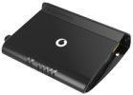
LED Operation mode
For aesthetic or power saving reasons, the LEDs can be configured to switch off automatically after a certain period of time after device boot up.
This allows the LEDs to be visible during configuration, but then to be inactive for the normal operation of the router
Time
Activity
For first XX minutes after power on
Internet
MachineLink 3G Router
Forever, until rebooted
MachineLink 3G Router
Notes:
Trainer Notes
Highlight the objectives to be covered within the course.
Do not present this slide just include it in the delegate notes.

Slide 7
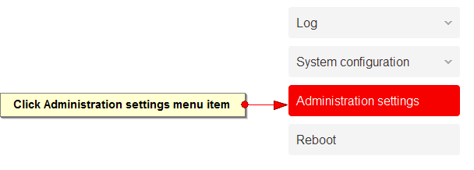
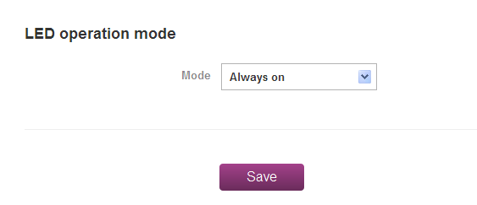
LED Operation mode
Configuring auto-power off timer is easy:
1
2
3
The default setting is ‘Always on’
Notes:
Trainer Notes
Highlight the objectives to be covered within the course.
Do not present this slide just include it in the delegate notes.

Slide 8
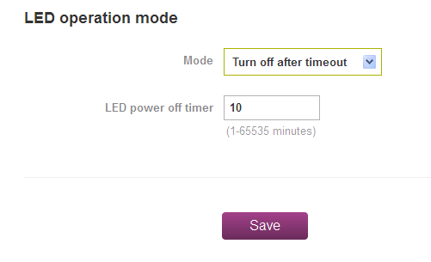
LED Operation mode (continued)
4
Changing the mode to ‘Turn off after timeout’ reveals the LED power off timer field. Enter the time in minutes to wait before the LEDs are turned off.
Click Save to confirm the changes.
LEDs can be reactivated temporarily by either rebooting the unit, or permanently by changing this setting back to “Always On”

Slide 9
LED Problems
The router has been plugged in and all or most of the LEDs are red, with the power LED blinking red.
Q1: What do you think this means?

Slide 10
LED Problems
A1: The LED display is indicating that there is
no SIM inserted into the router
a cellular phone module is not present
a general hardware error
Q2: What do you think this LED display is indicating?

Slide 11
LED Problems
A2: The SIM is PIN locked.
Q3: All LEDs on the router are off but the power is connected. When you disconnect the power and reconnect it, the lights come on for a moment while the router powers up and then they go out again.
What’s wrong?

Slide 12
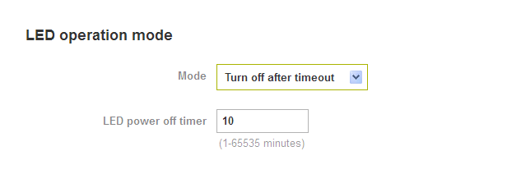
LED Problems
A3: The most likely cause of this is that an LED timeout has been configured enabling the router to operate without the LEDs lighting up. You can confirm this by checking the LED operation mode setting under System > Administration settings.

